Slide 1
EIF/UNDP customized training
MODULE: Monitoring and evaluating the TIPSWAP
Lilongwe, 4th August, 2015

Slide 2
LEARNING OBJECTIVE
Participants are exposed to key concepts, experiences and lessons learned on monitoring and evaluation (M&E) for sector wide approaches. Options for enhancing the TIPSWAP M&E are identified, discussed and analyzed.

Slide 3
Module 1: outline
SESSION 1
Introduction to M&E (Why? What? How?)
Key concepts, results chain and lessons learned
SESSION 2
M&E function in the TIPSWAP
SESSION 3
Group work: designing and using M&E

Slide 4
SESSION 1
KEY CONCEPTS

Slide 5
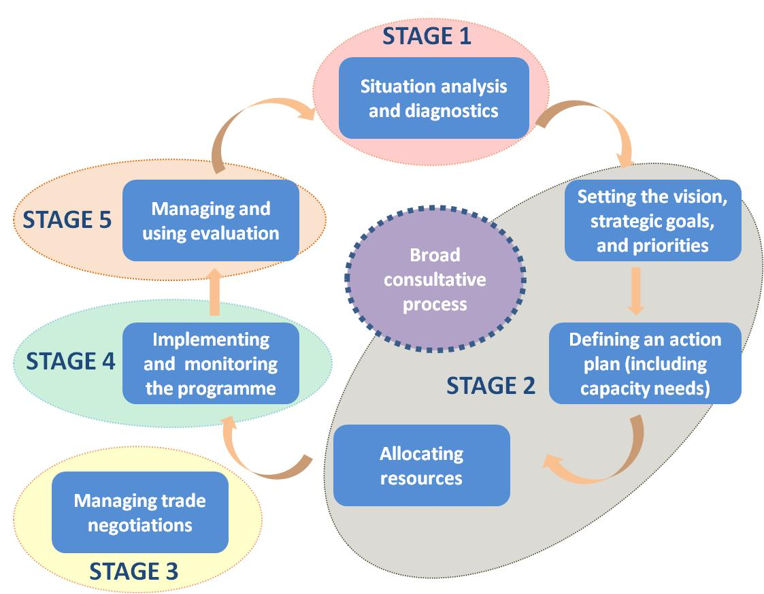
Policy cycle

Slide 6
For whom? TIPSWAP
Definition
“All significant funding for the sector supports a single sector policy and expenditure programme, under government leadership, adopting common approaches across the sector, and progressing towards Government procedures to disburse and account for all funds.” (Foster, 2009)

Slide 7
For whom? TIPSWAP
A new way of implementing policies and
coordinating trade-related assistance
All significant funding agencies support a shared, sector wide policy and strategy – the JSP
A medium term expenditure framework or budget which supports this policy (?)
Government leadership in a sustained partnership (?)
Shared processes and approaches for implementing and managing the sector’s strategy and plan - YES
Commitment to greater reliance on Government financial management and accountability systems (?)

Slide 8
Why?
Focus on results vs. activities
Guarantee transparency and accountability
Measure and communicate results
Enhance strategic focus of a strategy/plan
Get more funds!

Slide 9
What? measuring results
Results are changes in a state or condition that derive from a cause-and-effect relationship. There are three types of such changes (intended or unintended, positive and/or negative) that can be set in motion by a development intervention – outputs, outcomes and impacts.
UNDG agreed RBM terminology

Slide 10
Results-Based M&E
PLANNING
INPUTS
OUTPUTS
OUTCOMES
IMPACTS
What we invest
What we
do
What capacities we help develop
What results we help achieve
What we will see in lives of people in long-term
IMPLEMENTATION
Notes:
In planning we vision what we want to see in the long term or impacts. Then we work backwards to outcomes < outputs < activities < inputs.
Then we implement according to that chain. RB-M&E is about not limiting monitoring to outputs, but going beyond to see if we are working towards the higher level results.

Slide 11
GOAL (or IMPACT)
The higher-order national objective to which a development intervention is intended to contribute. It can be described as the positive long-term effects on identifiable population groups produced by a development intervention.
Malawi: double exports and economic diversification by 2019
Source: JSP

Slide 12
OUTCOME
Actual or intended changes in development conditions that interventions are seeking to support.
Oil seeds: Increased production through more efficient farming and higher yields and more irrigated oil seed produce. Increased quality of produce. Increased exports due to increased ease of exporting as regulations are more transparent
Notes:
Refer to pages 56 and 57 of Handbook
Public sector investment programme makes provision for substantial increase in the real allocation to gender equality and women’s empowerment.
National budget allocation procedures and processes require gender analysis of all investment decisions.
12

Slide 13
Outcome: typical pitfalls
Wordy (..and no change language)
Too ambitious
Containing multiple results
Wishy-washy (Support provided to improve..)
So general, they could mean anything
Overlapping with other goals
Confusing means and ends

Slide 14
OUTPUT
Deliverables/end-results, e.g. new skills or abilities, new products and services. They must be achieved within the target period by a responsible entity that has a high degree of control in delivering.
Oil seeds: market linkages improved between seed producers and irrigation farmers
Notes:
Outputs is where the specific comparative advantages of different agencies emerge
Outputs are not completed activities – the represent the changes resulting from the completion of a set of activities
(eg. Training conducted; Workshop completed; Survey implemented – these are activities)

Slide 15
Output: typical pitfalls
Wordy
Unclear logic and confused indicators
Over-ambitious
Passive voice and wishy-washy (i.e. Support provided to improve)
Overlapping with outcomes or repeating activities

Slide 16
SESSION 1
HOW TO DESIGN AN M&E FRAMEWORK

Slide 17
What is M&E framework?
1. Prioritize results (what results to measure)
2. Refine results (outcomes and outputs, when needed) and hold entities accountable (assign responsibilities for outcomes and outputs, when unclear)
3. Develop the reporting tool (How you will measure/document results in an excel table)
4. Measure results (who will populate the excel table)

Slide 18
STEP 1: prioritization
JSP has currently 1 goal, 13 outcomes and 34 outputs.
Start small and where it is easier to achieve and measure results, e.g. oil seeds.
In the 1st year SWG to prioritize 5 outcomes and develop an M&E framework for those. Learn from the process. Then expand.
Don’t let us/consultants do it all for you. It rarely works!

Slide 19
STEP 1: prioritization, cont.
Four criteria:
Clarity and consensus on outcomes and outputs
Potential to achieve measurable results by 2018
Seed resources available for programming
Commitment of responsible entities and partners

Slide 20
STEP 2: results & responsibilities
For the 5 prioritized outcomes, make sure that outcomes and outputs are properly formulated, clearly understood and there is sufficient consensus on implementation
If not, arrive at a consensus in the TWG on what needs to be done and by whom
At the end of the process, make sure there is a clear identification of responsible parties
SWG to endorse any change to the JSP

Slide 21
STEP 3: reporting tool
LINK TO EXCEL FILE

Slide 22
STEP 4: M&E responsibilities
Who is responsible for…
Designing the reporting tool (i.e. indicators, baselines and targets)?
Validating and endorsing the reporting tool?
Collecting data and compiling quarterly monitoring reports?
Validating and endorsing the monitoring reports?
Commissioning independent evaluations?
Communicating results?

Slide 23
SESSION 1
HOW TO DESIGN THE REPORTING TOOL

Slide 24
Indicators
Indicators describe how intended results will be measured - accountability
Objectively verifiable, repeatable measures of a particular condition
They force clarification of what is meant by the result …….the fine print!
Must be accompanied by baselines and targets
Max 2 indicators per outcome – fewer the better – 1 indicator per output is sufficient
For each outcome add 1 sustainability indicator to control for social and/or environmental impact

Slide 25
Baseline, Target and Results
Performance
Target
Planned
level of
achievement
Results
at end of period
Baseline
INDICATOR
Current
level of
achievement

Slide 26
What are SMART indicators?
SPECIFIC
Is the indicator specific (i.e. quality, time, target groups, baseline)?
MEASURABLE
Will the indicator show desirable change?
Is it a reliable and clear measure of results?
Is it too sensitive to changes in policies and programmes?
Do stakeholders understand/agree on exactly what to measure?
ACHIEVABLE
Are the result(s) realistic and based on risk assessment, and other factors?
RELEVANT
Is it relevant to the intended result?
Does it reflect expectations and success criteria?
TRACKABLE
Are data actually available at reasonable cost and effort?
Can proxy indicators be used?
Are data sources known?
Notes:
OBJECTIVE:
- Wall painted in white

Slide 27
Types of indicators
Factual indicators Factual (yes/no) Existence (yes/no) Classes (x/y/z) | Policy recommendation submitted Law passed by Parliament Chamber of Commerce established Existence of automated customs: automated, partly, not automated
Numeric indicators Number Percentage Ratio | No. of government officials trained No. of networks on trade related-subjects created No. of CSOs attending conference on trade % of government budget devoted to trade sector % of enterprises with access to single window Ratio of jobs created by exporting SMEs

Slide 28
Indirect (Proxy) Indicators
Purpose | Direct indicator | Proxy indicator as substitute
Improvements in customs administration | Quality of customs improved -> difficult and expensive to pass the border | Number of days required to export/import a container to XX Number of documents to be processed electronically
Increase in per capita income in the poorest state | household income -> household income survey needed -> not frequent enough | Changes in local retail sales Increase in the total number of cell phone users in the state
To increase per capita income of small farmers | Crop sales and food consumption -> survey needed -> too expensive | Purchase of typical consumer items Improvement in buildings (e.g. roof) of life style (consumption of meat per week)

Slide 29
Outcome indicators: sugar
Increase the scale in production and milling of sugar cane | Total production of raw sugar cane (volume) Total production of refined sugar (volume) Average yields Cost of production per ton of refined sugar
Improve quality and pricing | Price per ton (note: assumption no major fluctuation in international prices) Number of private sector and government labs accredited by internationally recognized bodies
High value processing | Number of HS 6-digits lines where Malawi records exports (Sugar and Sugar Confectionery) Percentage of Sugar Confectionary exports over Raw sugar exports
Notes:
29

Slide 30
CAMBODIA OUTCOME | BASELINE | TARGET
Outcome 9: SEZs Cambodia’s SEZs improve their competitiveness and attract more manufacturing investment to become nodes in regional production networks | 2012 contribution of manufacturing to GDP (exclusive of garment and footwear) approximately 5% | The contribution of manufacturing to GDP (exclusive of garment and footwear) increases to 7% by 2018 | Private Sector, CDC, MoIH, MoC
 | 69 light manufacturing operators in Cambodian SEZs in 2012 | 140 light manufacturing companies operators in Cambodian SEZs in 2018 | Private Sector, CDC, MoC
Outcome 12: Milled Rice Cambodia achieves the 1 million MT target for export of milled rice set out under the Rice Policy | Approximately 350,000MT of milled rice exported in 2013 | More than 1 million MT of milled rice exported in 2018 | Private Sector, MoC, MAFF, SNEC

Slide 31
Output indicators
Government staff have improved trade analysis skills | Number of staff trained by end 2013 % of staff trained that were rated as more effective in doing their jobs 1 year later
Quality of study produced, and used to inform public policy | Number of copies of study distributed Percentage of Parliamentarians who receive copy Extent to which findings of the study were used to inform high-level policy discussions and decisions Extent to which findings have influenced major initiatives or budget allocation
Government and private Sector organizations in xx districts have resources and skills to improve quality standards | Number of staff completing training in quality standards by end 2013 % of staff who believe they are more effective in undertaking their tasks after they received training
Draft trade policy formulated and submitted to Cabinet | Progress made in drafting new policy Stakeholder satisfaction with quality of draft new policy
Notes:
31

Slide 32
CAMBODIA OUTPUT | BASELINE | TARGET
Dry-season production improves through introduction of improved dry-season rice seeds, including high value fragrant seeds | CARDI has de-facto monopoly in seeds production | Allow Private Sector competition in seeds production | MAFF
Capacity of rice millers to meet basic Hazard Analysis & Critical Control Point (HACCP) or Good Manufacturing Practice (GMP) standards is developed through rice mills certification program | No modern rice mills certified as of 2012 (one plant certified by ISC, but ISC is not internationally accredited as of yet so this certification has no export value) | 10 Cambodia rice mills that are HACCP or GMP certified in 2016 | Private Sector, MoIH, MAFF

Slide 33
Sustainability indicators
Objective: check for social/environmental impact
Goal: Maximize the potential growth sectors … fostering job creation; empowering rural communities; ensuring equitable access to land; and promoting sustainable use of the environment. (MSDG II)
Goal level headcount poverty in rural areas
Outcome level number of jobs (e.g. in oil seeds or sugars)
rate of deforestation or re-forestation
number of fair trade / organic certification
measure of soil degradation

Slide 34
 | Input | Activity | Output | Outcome | Impact
Sector-specific expertise in disaster preparedness developed
Income of low-income families increased
To train community members in customs management
By 2013, livelihoods of agriculture dwellers are more secure
International consultants to conduct study
Capacities created for an extended response to food security emergencies
New businesses and jobs are created in targeted, poor rural areas
Study tour
National and local policies and plans are responsive to gender issues
By 2016, SMEs growth rate rate is above 10 percent
Low-income families acquired the skills necessary to sustain micro-enterprises in export sectors
Policy and regulatory environment improved for small enterprises
Pro-poor trade policies drafted
Notes:
exercise in pairs;
15 minutes

Slide 35
 | Input | Activity | Output | Outcome | Goal
Sector-specific expertise in disaster preparedness developed
Income of low-income families increased
To train community members in customs management
By 2013, livelihoods of agriculture dwellers are more secure
International consultants to conduct study
Capacities created for an extended response to food security emergencies
New businesses and jobs are created in targeted, poor rural areas
Study tour
National and local policies and plans are responsive to gender issues
By 2016, SMEs growth rate rate is above 10 percent
Low-income families acquired the skills necessary to sustain micro-enterprises in export sectors
Policy and regulatory environment improved for small enterprises
Pro-poor trade policies drafted
Notes:
exercise in pairs;
15 minutes

Slide 36
SESSION 2
UPDATE FROM THE MINISTRY OF INDUSTRY AND TRADE

Slide 37
SESSION 3
GROUP WORK

Slide 38
GROUP WORK
Objective: develop draft indicators for the JSP
Type of engagement: group brainstorming
Tasks:
1. Select 2 outcomes of the JSP (15 minutes)
2. For each outcome propose 2 outcome indicators
3. Select 1 outcome and propose 1 indicator per output
4. For the outcome selected propose 1 sustainability indicator

